Slide 1
Machine Learning Project on Regression: Order Delivery Time Prediction

Slide 2
Objective
The goal of this project is to predict the number of days required for an order to be delivered to a customer.
The idea is to improve the customer experience.
Predicting actual delivery days taken to deliver an order will help improve the timeline that the company gives for estimated delivery days.
This in turn will help the company to provide precise estimated delivery days, which will help the customers to have proper knowledge the delivery date of their orders.

Slide 3
Data Preparation
Dropped features that were not related to our target variable like reviews related features.
Removing NA values
Creating our target variable: Delivery time in days
Also created estimated delivery time in days
Checking whether the dates are not falling on any Public holidays in Philadelphia
Dropping other datetime features

Slide 4
Exploratory Data Analysis

Slide 5
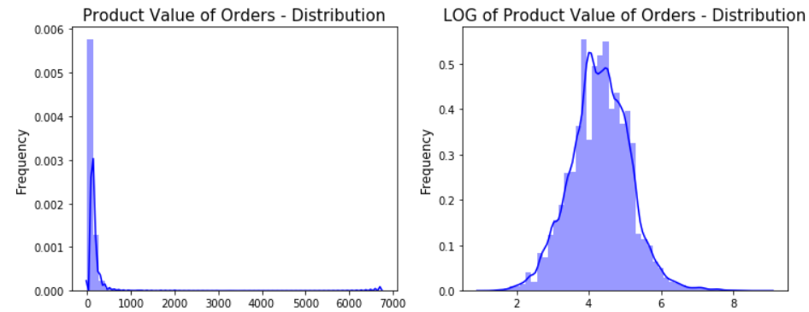
Skewness Plot

Slide 6
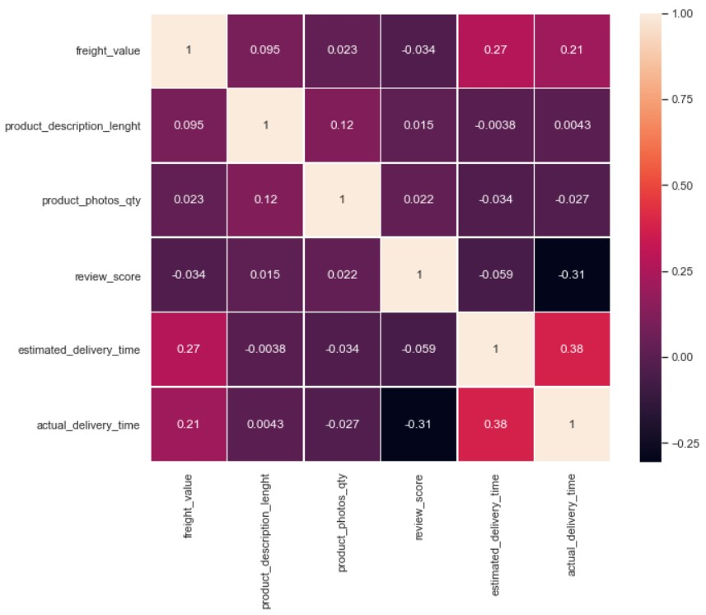
Correlation heatmap

Slide 7
Evaluation Metric
Dataset Type | Course of Action | R2 Score | RMSE
Test Data | Applying Linear Regression without any transformations | 0.28 | 8.048
 | Log Transformations | 0.405 | 0.506
 | After Removing Outliers | 0.4834 | 0.411
Train | Applying Linear Regression without any transformations |  | 7.81
 | Log Transformations |  | 0.504
 | After Removing Outliers |  | 0.413

Slide 8
Thank You

